Slide 1
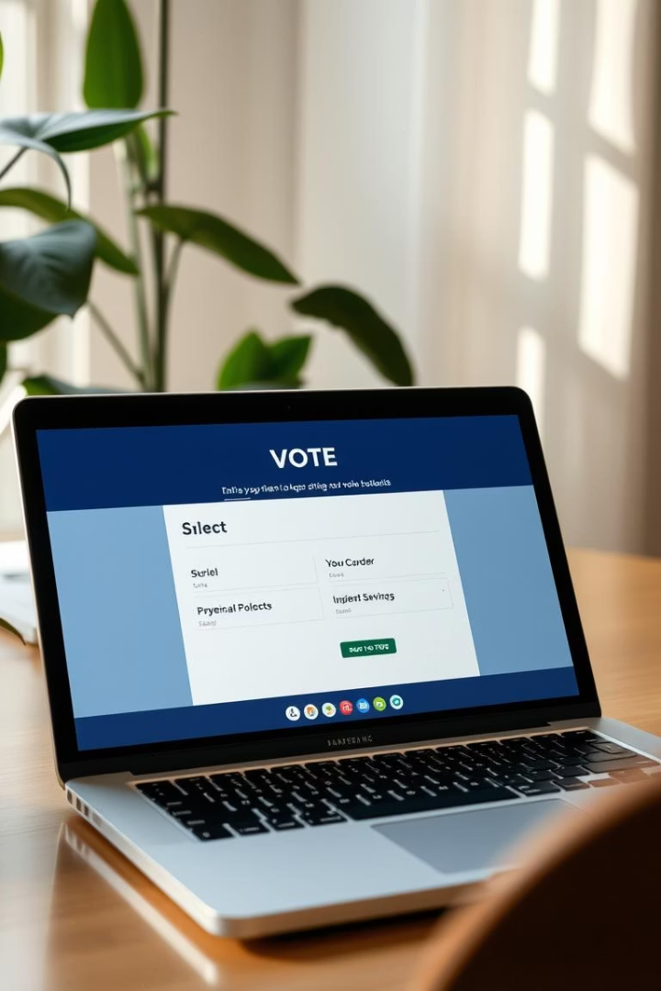

Online Voting System: Streamlining Elections with Polling Interface.
This Online Voting System using polls is a secure, user-friendly online platform. Efficient and transparent election processes developed for different organizations.
by Irakoze Vanny grace

Slide 2
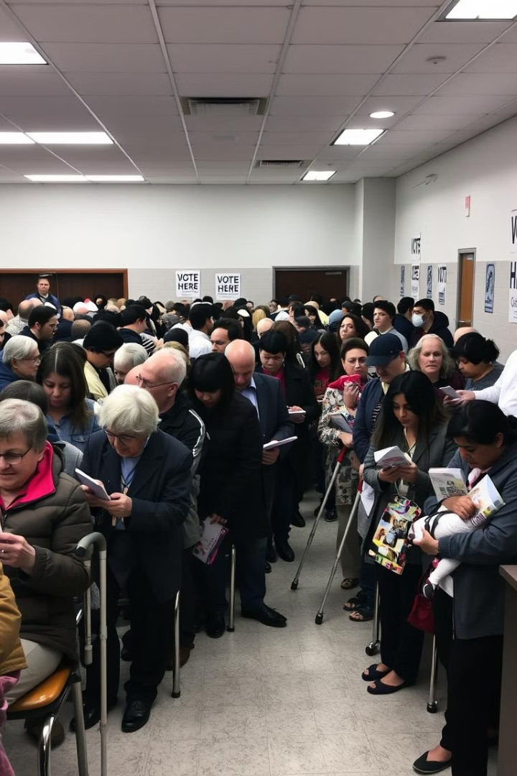
Problem Statement: Challenges in Traditional Voting
Low Voter Turnout
Averages 55-60% in recent elections, limiting democratic participation.
High Costs
Administrative budgets exceed $1 million per major election cycle.
Accessibility Issues
Challenges for disabled and remote voters reduce inclusivity.
Security Concerns
Paper-based systems vulnerable to tampering and fraud.

Slide 3
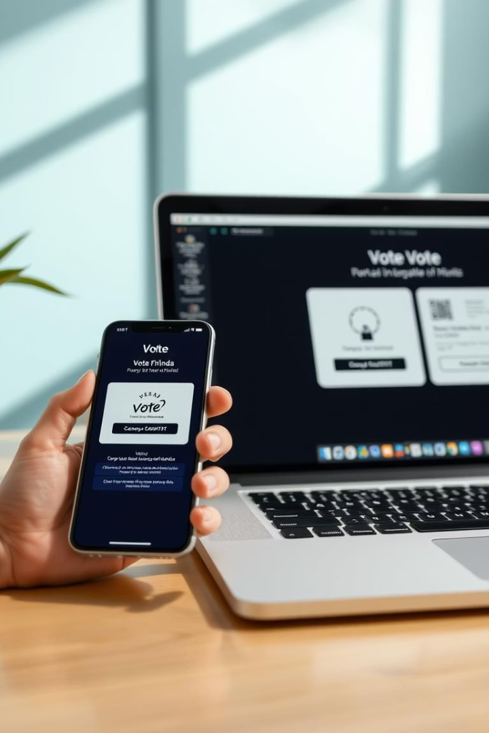
Proposed Solution: An Online Voting System
Intuitive Web Interface
Easy access to polls integrated within a sleek platform.
Strong Security
Authentication, authorization, and data encryption built-in.
Real-Time Reporting
Instant vote tallying and analytics for transparent results.
Cross-Device Accessibility
Accessible anytime, anywhere on any internet-enabled device.

Slide 4

Data Flow Diagram: Registration and Authentication
User Registration
Email verification ensures valid accounts.
Secure Login
Multi-factor Authentication (MFA) protects user access.
Data Security
AES-256 encryption safeguards sensitive information.

Slide 5
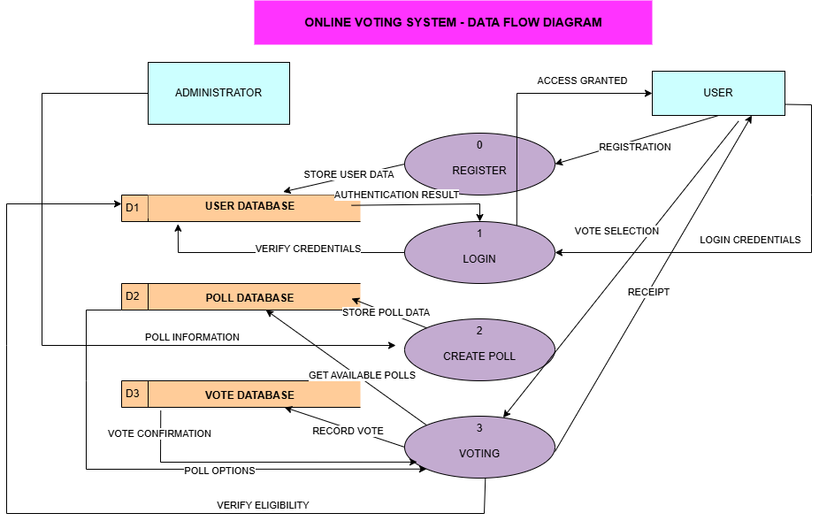
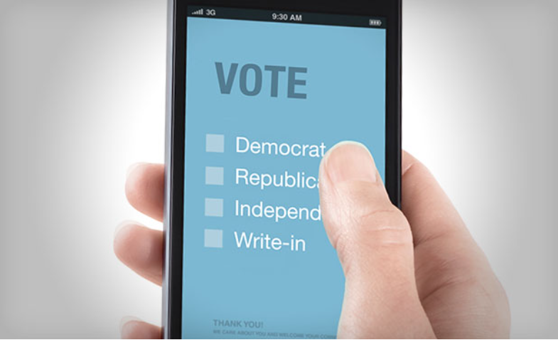
Data Flow Diagram: Voting Process

Slide 6
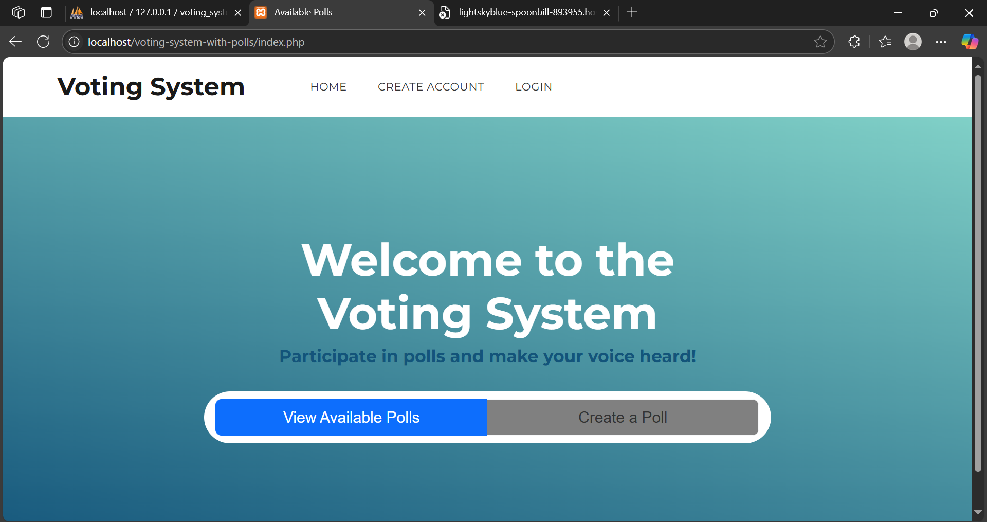
Screenshots and Interface details.
“Here is a screenshot of a web-based Voting System homepage featuring user registration, login options, and two main actions:
1- viewing available polls and
2- creating new polls.
The intuitive interface allows participants to easily engage in the voting process."

Slide 7
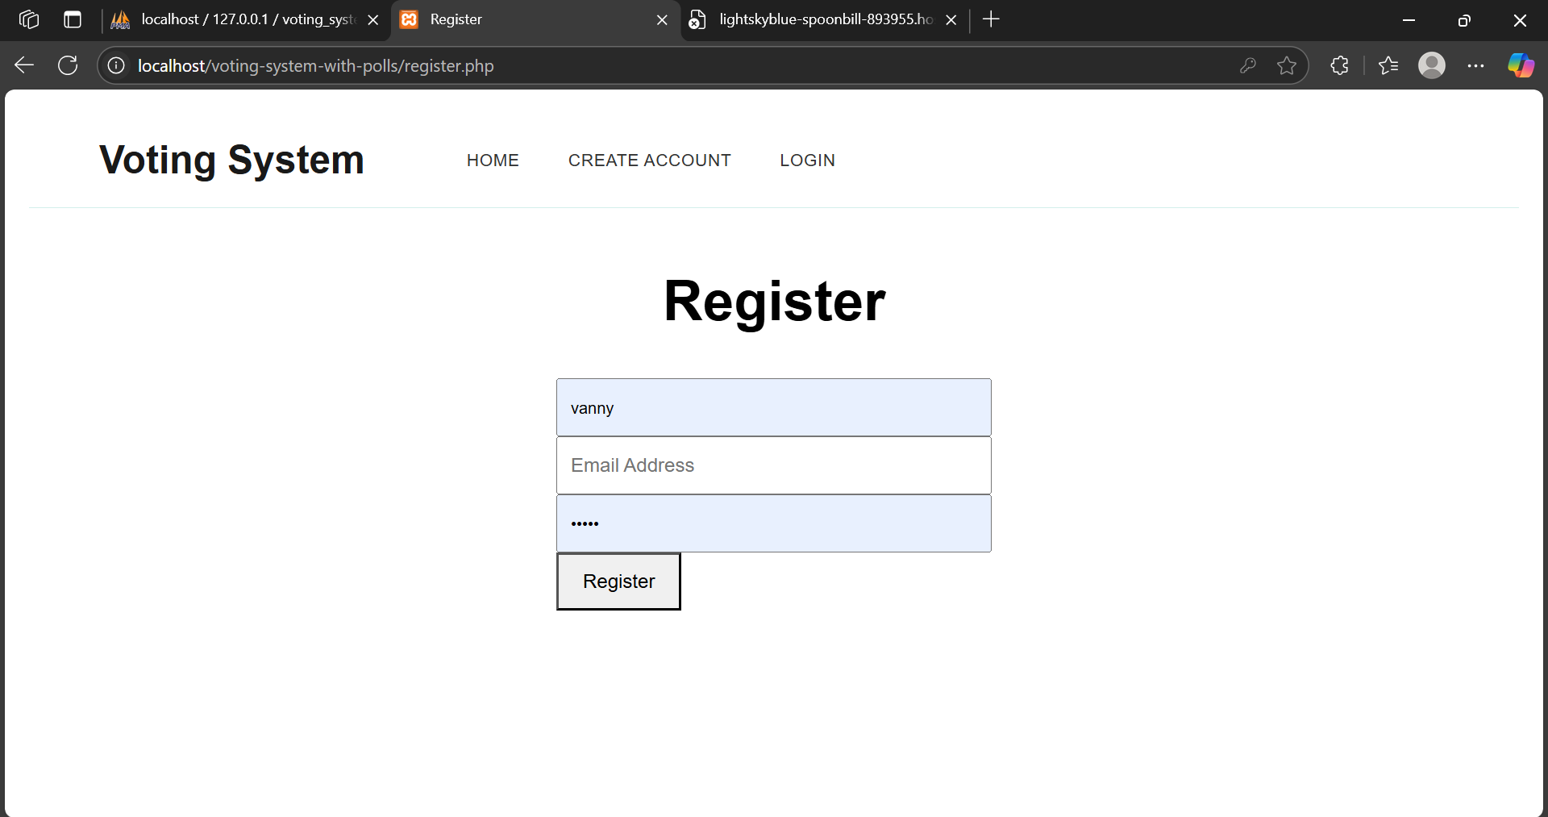
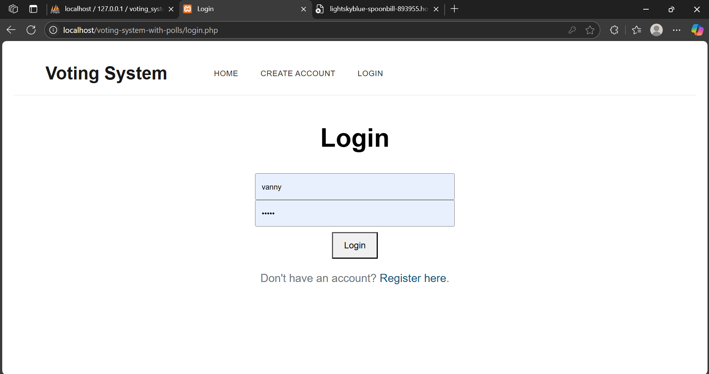
In the below 2 images here is a side-by-side view of the Voting System's registration and login pages. The left panel shows the user registration form with username, email, and password fields, while the right panel displays the login interface with username and password inputs, plus a link for new users to register before voting on our platform to ensure the privacy of citizens.

Slide 8
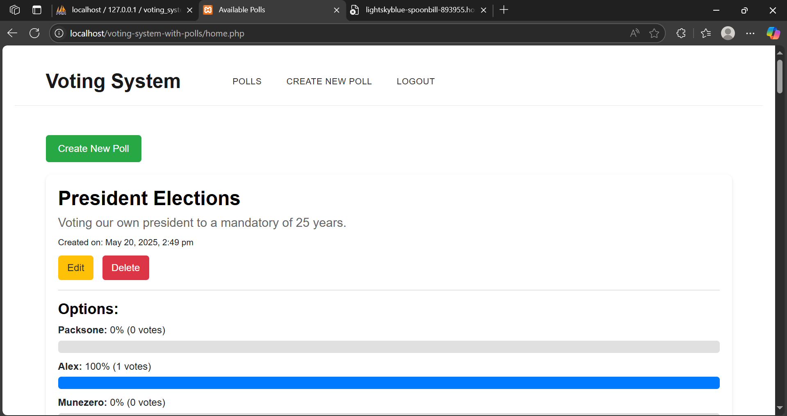
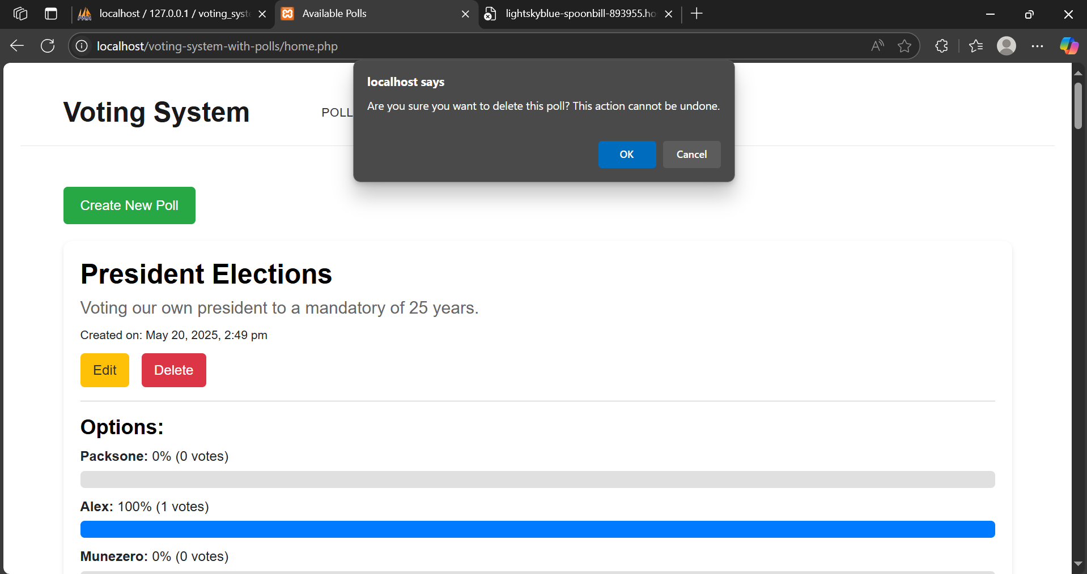
This is a split-screen view of the Voting System poll management interface. The left side shows a "President Elections" poll with voting options and results which indicates when a user what to create a poll. The right side displays the same poll with a confirmation dialog asking "Are you sure you want to delete this poll? This action cannot be undone," demonstrating the system’s message safeguards against accidental poll deletion.

Slide 9
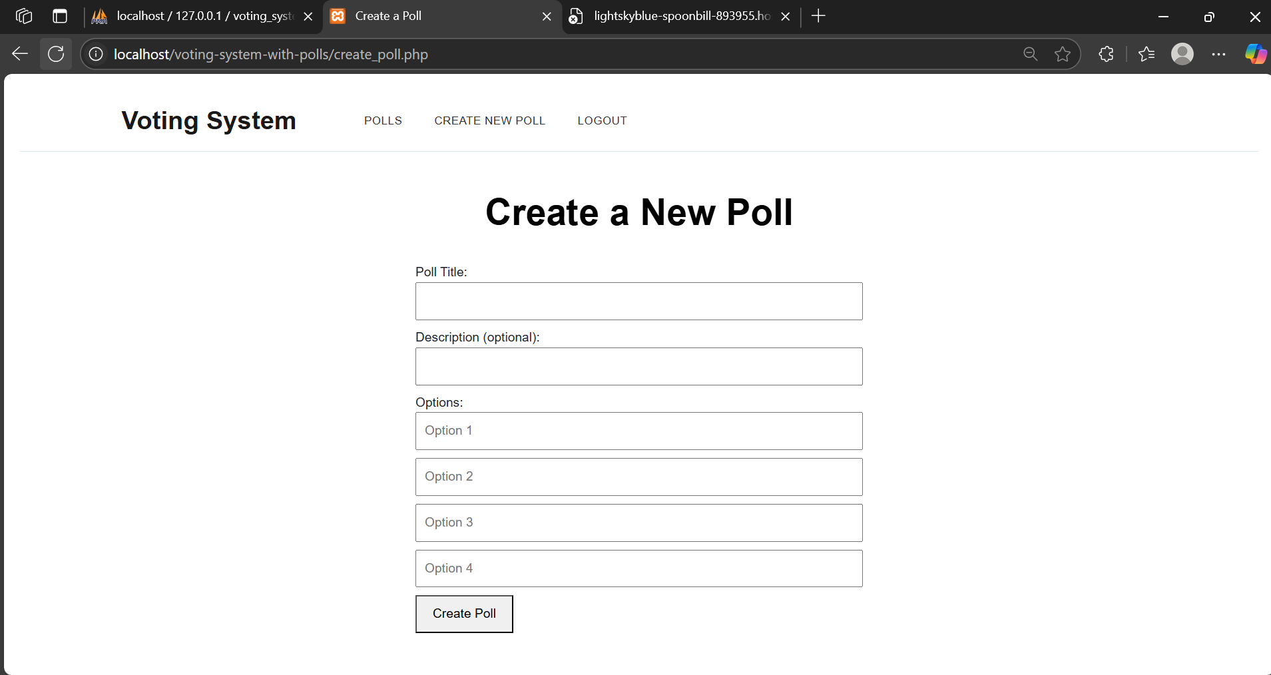
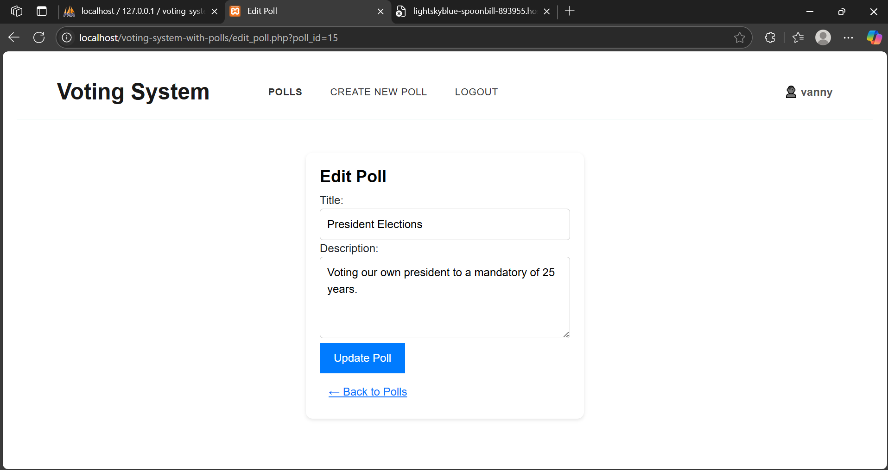
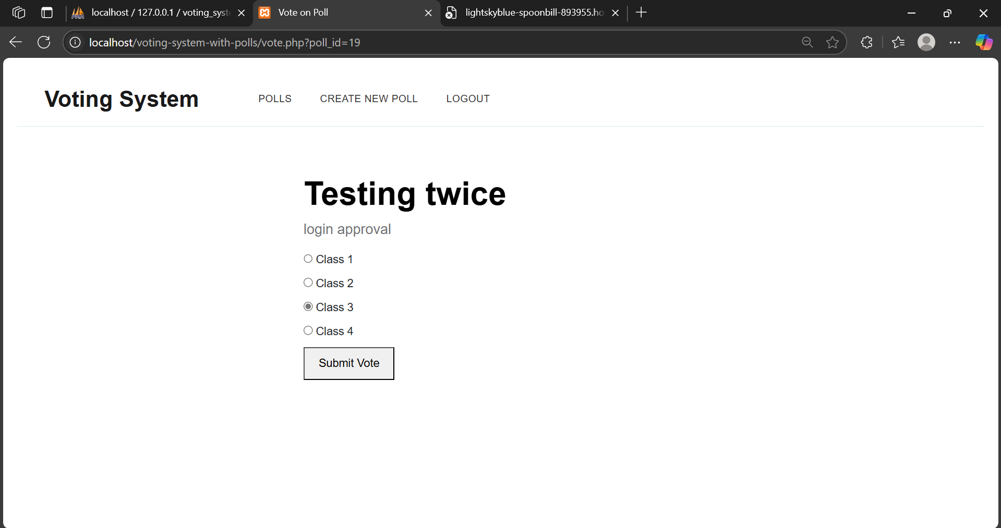

Slide 10
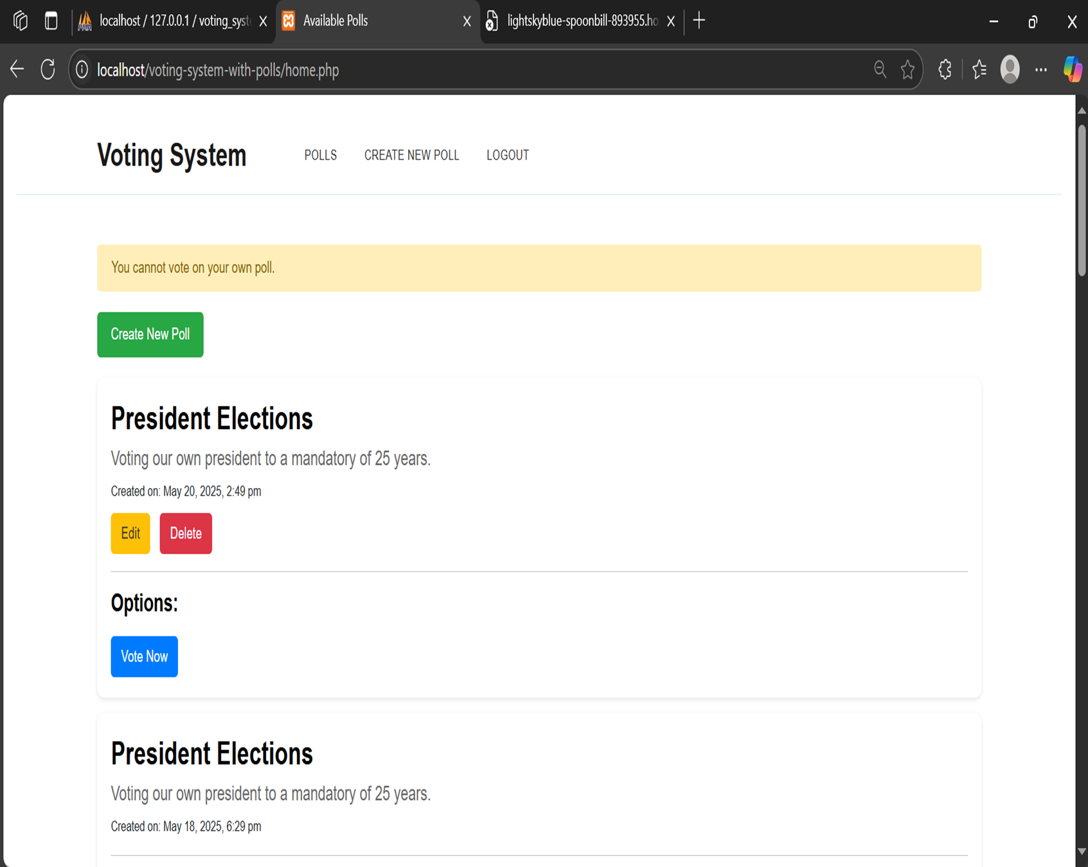
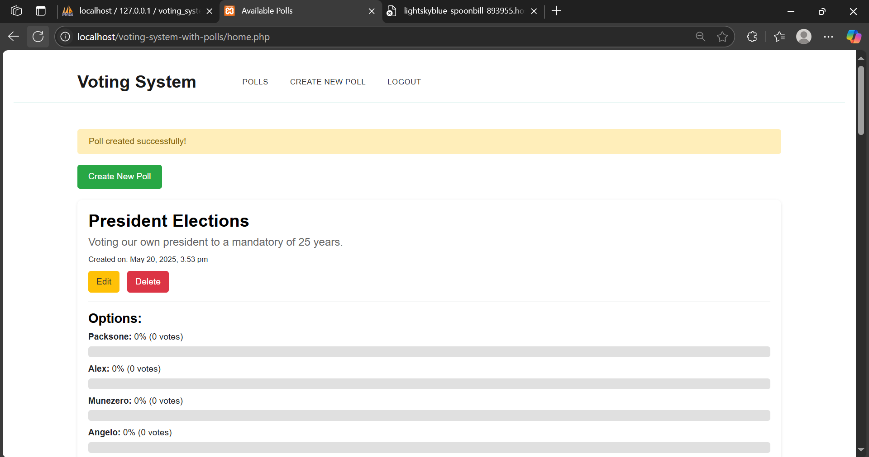
These are the last 2 images of the interface screenshots that displaying the Voting System interface showing different poll states with their validations. The left image shows a warning message "You cannot vote on your own poll“. The right image displays a success notification "Poll created successfully". As the messages which have to be received by the user after voting or wants to create a poll.

Slide 11





Benefits of the Online Voting System
Higher Turnout
Cost Savings
Reduces administrative expenses by up to 40%.
Boosts participation by 20-30% with convenience.
Enhanced Security
Improved Access
Tamper-proof and transparent election processes.
Inclusive for disabled and remote voters.

Slide 12

Conclusion
Efficient & Secure
Streamlines elections while ensuring data protection.
Accessible
Promotes civic engagement from anywhere.
Customizable
Tailored to meet your organization’s needs.
Next Steps
Q&A to explore your specific requirements.

